Slide 1
C# language features

Slide 2
Objectives
Learn to work with some of the more advanced C# language features
C# types
Attributes
Extension methods
Null-conditional operator
Readonly
Anonymous types
Delegates and events
Lambda’s

Slide 3
C# types
C# language features

Slide 4
C# is strongly typed
Every variable should be declared with a type
Two categories of types
Value type
A variable of a value type contains an instance of the type
int, double, float, bool, DateTime, char, …
Microsoft docs
Reference type
A variable of a reference type contains a reference (memory address) to an instance of the type (located in the heap)
E.g. string, TextBox, Random, Console, …
Microsoft docs
Every type is either a reference type, or a value type

Slide 5
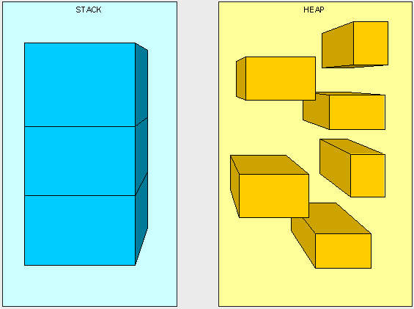
Stack and Heap
Two places where .NET stores items in memory
Stack
Heap
Notes:
There are two places the .NET framework stores items in memory as your code executes: the Stack and the Heap.
Both the stack and heap help to execute code.
They reside in the operating memory on our machine and contain the pieces of information needed to make it all happen.

Slide 6
Stack
Responsible for keeping track of what’s executing in code
Per method call a block of memory is allocated that holds
Parameter values
Values of local variables
Actual value of the parameters / local variables depend on the sort of type:
Reference types: copy of a reference to the instance (heap address)
Value types: copy of the instance itself
When the ref or out keyword is used for parameters a reference is always copied
LIFO (last in, first out) => only the top block can be accessed (like a stack of cards)
When a method is done executing the top block is thrown away, exposing the block below
Notes:
When you call a method, a new block of memory is allocated on the Stack.
A Stack is a LIFO structure, so the last allocated block is released first (e.g. a stack of cards).
Per block of memory, you will find:
Actual values of the parameters (parameter binding). Depending on the way this occurs (by value or by reference) you will find different values:
Reference types : copy a reference to the object. The actual object resides on the heap
Value types: copy the whole object onto the stack. This is a thus a copy.
When you use the ref/out keyword, you always copy a reference (pointer) to the object.
Local variables are also allocated on the stack. However, depending on the type (Value or Reference) you allocate the object itself or a reference to the heap.

Slide 7
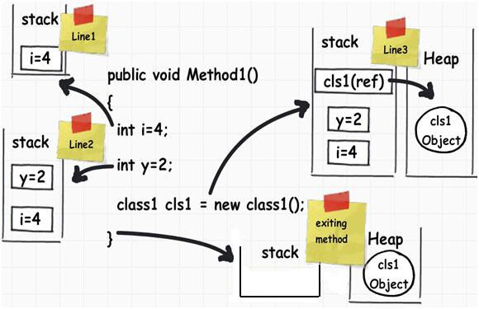
Heap
Responsible to hold information (instances)
All instances can be accessed all the time (no LIFO)
Has to worry about garbage collection (removing unused instances) to keep it clean
Notes:
The Heap is similar to the Stack except that its purpose is to hold information (not to keep track of execution). This means that anything in the Heap can be accessed at any time.
With the Heap, there are no constraints as to what can be accessed like in the stack.
The Heap is like the heap of clean laundry on our bed that we have not taken the time to put away yet - we can grab what we need quickly.
The Stack is like the stack of shoe boxes in the closet where we have to take off the top one to get to the one underneath it.
The Stack is self-maintaining, meaning that it basically takes care of its own memory management. When the top box is no longer used, it's thrown out.
The Heap, on the other hand, has to worry about Garbage collection (GC) - which deals with how to keep the Heap clean (no one wants dirty laundry laying around... it stinks!).

Slide 8
Value type
Variables hold the value
No reference to the heap
Two variables cannot point to the same instance. On assignment a copy is made.
int y = 32; // y holds the actual value 32 and not a reference to it
int x = y; // copy the value 32 into x
Many built-in types (Primitives) are value types
int, double, float, bool, char, …
Some of the types in the .NET class library are value types
DateTime, KeyValuePair, …
You can define your own with the struct keyword
Value types are fast to instantiate
Notes:
A variable of a value type, holds the actual value.
e.g. int y = 32 ➔ y holds the actual value 32 and not a reference to it.
If you assign a variable to another, you COPY the value.
e.g: int x = y → you COPY the value of 32 and assign it to x
Because you don’t hold a reference but the actual value, these types are fast to instantiate.

Slide 9
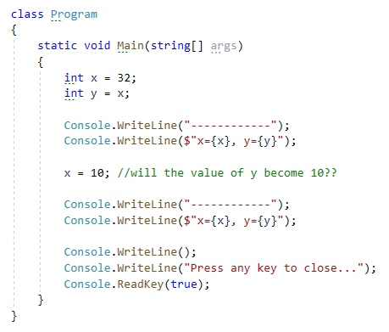
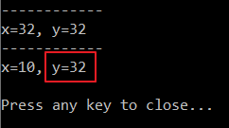
Value type

Slide 10
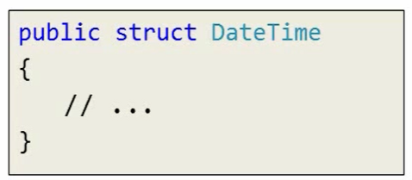
struct
Struct definitions create value types
Should represent a single value
Should be small (because they are copied frequently)
Microsoft docs
Notes:
How do you create a value type?
We know now that we are always creating a reference type when we create a class definition, but what about value types?
One way to create a value type with C# is to create a structure using the struct keyword.
A struct definition looks just like a class definition because it has a name, it has an opening and closing curly brace, and everything inside of those braces will be a member of the structure.
How do you decide if you should write a class or a struct?
The general rule of thumb is that you want to write a class by default.
Structs are meant for special cases when you need to write an abstraction that represents a single value, like a DateTime represents a single value.
Even though you can break a DateTime down into smaller constituent pieces, like the current hour of the DateTime or the current day or the current year, a DateTime does represent something that we can reason about as a single value, a single value that is a point in time.
Some other value types, like integers, they are obviously single valued, and custom value types can, for example, be made to represent complex numbers, a point in two or three dimensional space, and currency amounts. Those all represent single values conceptually.
The other thing that they have in common is that they are all small. Structs do best when they contain a small amount of data because these values are copied frequently.
Every time we pass a value to a method the runtime has to make a copy of that value and you don't want a struct to contain thousands of bytes of information, that would be expensive to copy. Values like int32, where the number 32 represents the number of bytes required to store that integer value, that's 4 bytes of data, and most CPUs will copy that in 1 CPU cycle.
Limitations of a struct
Cannot declare a parameterless constructor. Every struct already provides an implicit parameterless constructor that initializes al the fields with their default value.
Cannot initialize an instance field or property at its declaration
A constructor must initialize all instance fields
Cannot inherit from other class or struct. However, a struct can implement interfaces

Slide 11
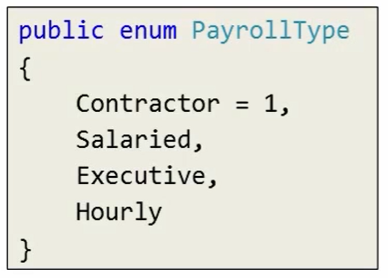
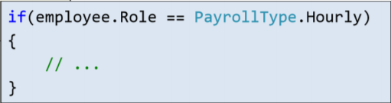
enum
enum creates a value type
Set of named constants
The associated constant values of enum members are of type int by default
Start with 0 and increase by one for each member definition
You can explicitly specify another int value
Notes:
Another way to create a value type in C# is to create an enum.
An enum creates a type that will only hold specific numerical values and enum, short for enumeration, is a good way to create name constants in your software.

Slide 12
Reference type
Variables hold a reference (pointer, memory address) to the instance on the heap
Multiple variables can point to the same instance.
On assignment a copy of the reference (memory address) is made.
Some built-in types (Primitives) are reference types
object, string
Most of the types in the .NET class library are reference types
Dictionary<Tkey, Tvalue>, Random, List, Console, …
You can define your own with the class keyword

Slide 13
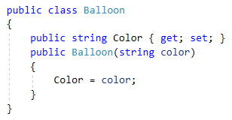
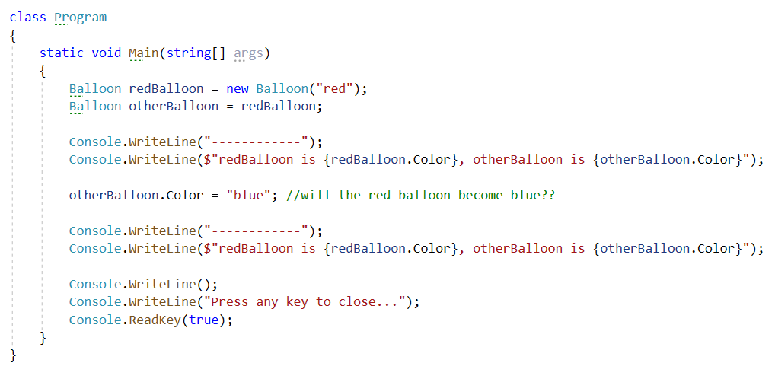
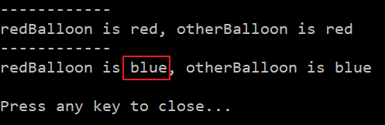
Reference type

Slide 14
Method parameters
Parameters pass “by value”
Reference types pass a copy of the reference (pointer, memory address)
Value types pass a copy of the value

Slide 15
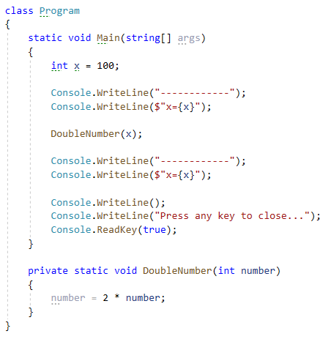
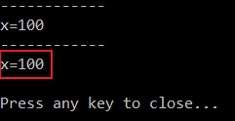
Method parameters

Slide 16
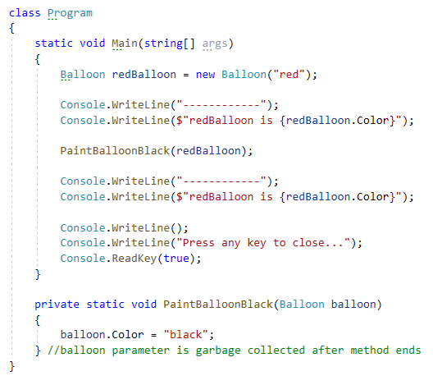
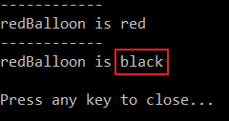
Method parameters

Slide 17
Pluralsight
C# Fundamentals
Module “Introduction to C#”
Clip: Types
Module “Classes and Objects in C#”
Clip: Reference Types
Module “Types and Assemblies”
Clip: Reference Types
Clip: Value Types
Clip: Method Parameters
Clip: Structs and Enums

Slide 18
Property Accessibility
C# language features

Slide 19
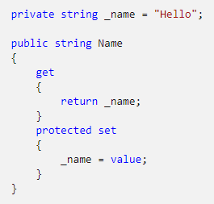
Accessor accessibility
The get and set portions of a property are called accessors
It is possible to restrict access to one of the accessors
In this example the get accessor receives the accessibility level of the property itself (public). The set accessor is explicitly restricted (protected) so that only the class itself and derived classes can set the Name property.

Slide 20

Auto-implemented properties
Restricting the access level of one of the accessors is also possible when working with auto-implemented properties.

Slide 21
Pluralsight
Need a reminder on the basics of Properties?
Check the C# Fundamentals course
Module “Members: Methos, Events and Properties”
Clip: Fields and Properties

Slide 22
Attributes
C# language features

Slide 23
Attributes
Provide a way of associating metadata with code
Can accept arguments in the same way as a method
A program can examine its own attributes or the attributes in other programs at runtime by using a technique called reflection (out of scope for this course)
Microsoft docs

Slide 24

Add attributes to code
Place the attribute between square brackets right before the piece of code you want to target
E.g. the Obsolete attribute can be used to signal that code is obsolete and shouldn’t be used anymore. The compiler will now produce a warning when the code is used somewhere

Slide 25
Attribute targets
Attributes can be used on a number of targets. The previous slide shows an attribute on a class, but attributes can also be used on:
Method, constructor
Type (class, struct, interface, enum or delegate)
Assembly (project)
Event
Field
Parameter
Property
ReturnValue
…

Slide 26
Extension methods
C# language features

Slide 27
Extension methods
Enable you to “add” methods to existing types without modifying the original type or creating a derived type
Static methods, but called as if they were instance methods of the extended type
Microsoft docs

Slide 28
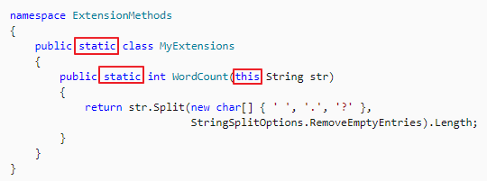
Example – Create extension method for string
Must be defined in a static class
Extension method must be static
First parameter is an instance of the class being extended preceded with the “this” modifier

Slide 29

Example – Using an extension method
Namespace of the static class that defines the extension has to be brought into scope with a using directive
Extension method can be called as if it is a member of the extended type

Slide 30
Null-conditional operator
C# language features

Slide 31

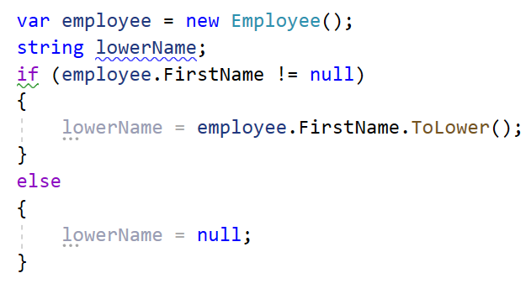
Syntax
?.
Applies a member access operation on an operand only if that operand is not null
Same as:
Notes:
string lowerName = employee.FirstName?.ToLower();
If the operand FirstName is null then the ToLower method will not be invoked. The variable lowerName will get the value null.
If the operand FirstName is not null the the ToLower method will be invoked. The variable lowerName will get the value returned by the ToLower method.
This operator can reduce the amount of if-tests that check for null to avoid a NullReferenceException and make the code more readable.

Slide 32
Readonly
C# language features

Slide 33

Readonly
Keyword that can be used in a field declaration
Indicates that assignment to the field can only occur as part of the declaration or in a constructor
A readonly field can’t be assigned after the constructor exits

Slide 34
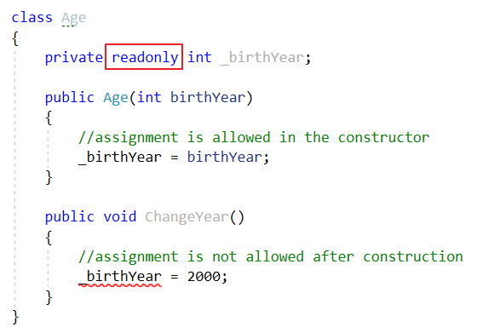
Example
Notes:
Notice the red squiggles in the ChangeYear method!
Also allowed:
private readonly int _birtYear = 2000;
=> Because the assignment happens at the same time as the declaration

Slide 35
Anonymous types
C# language features

Slide 36
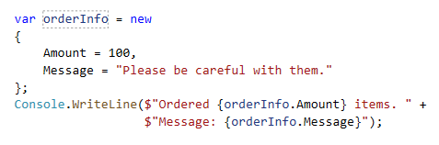
Anonymous type
Encapsulates a set of read-only properties into a single object without having to explicitly define a type first
You create anonymous types by using the new operator together with an object initializer

Slide 37
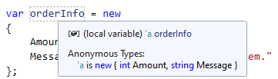
Anonymous type
Type name is generated by the compiler and not available at the source code level
Type of each property is inferred by the compiler
Typically used in the select clause of a LINQ query (we will cover LINQ in another chapter)
Microsoft docs

Slide 38
Delegates AND events
C# language features

Slide 39
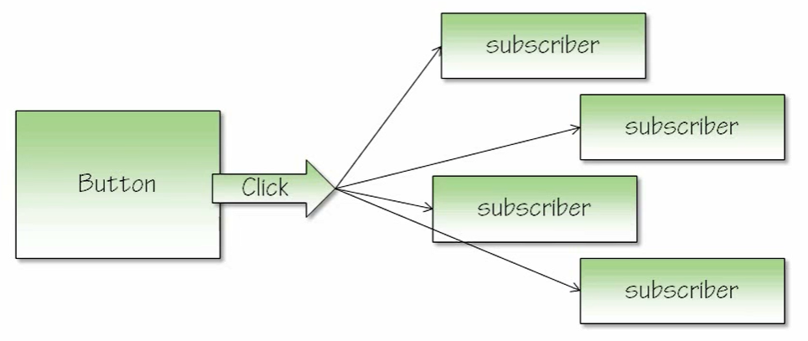
Events – Highlevel overview
Allows a class to send notifications to other classes or objects
Publisher (e.g. Button) raises the event (e.g. Click)
One or more subscribers process the event
To understand events, we need to know about delegates in C#
Notes:
Another type of member that you have in a class is an event.
To understand events we need to delve into some new concepts in C# and. NET, but before we do that let me give you a high-level overview of why events are useful.
Many times in software development we need to interact with or keep track of components that do interesting things at unpredictable times.
For example, a button on a screen is a component that we need to keep track of. We want to know when a user clicks on this button.
We don't know when the user will click on the button, that could happen at any time, but we do need to be notified when it does happen because when a user clicks we need to execute some code and write something to a file or retrieve some data.
I'm not just talking about components on the screen, I also might need to keep track of a directory on the hard drive and be notified when a user puts a new file in the directory or when a timer expires because I need some code to execute every 60 seconds and refresh some data, like refreshing stock quotes.
All of these are examples of when events can be useful.
Events allow a component, like a Button class, to announce to anyone who is listening that something interesting happened, like when someone clicks on the button, but it could also be that a mouse moved over the button or a mouse moved out of the button.
We would call the announcement for a click, a click event, and we say that the button publishes this event.
The code that is interested in a click event is code that subscribes to the event.
You can have multiple subscribers listening to a single event, so when a user clicks a button there could be three subscribers:
one piece of code saves a file
another piece of code changes the color of the screen
the third piece of code logs information to the database.
Those are three independent pieces of code all executing off the same event and the beauty of events is that the button class doesn't need to keep track of who is subscribing, and the subscribers don't need to know about each other.
It's all done through the magic of delegates in C#, so in order to understand events we first need to turn our attention to delegates.

Slide 40
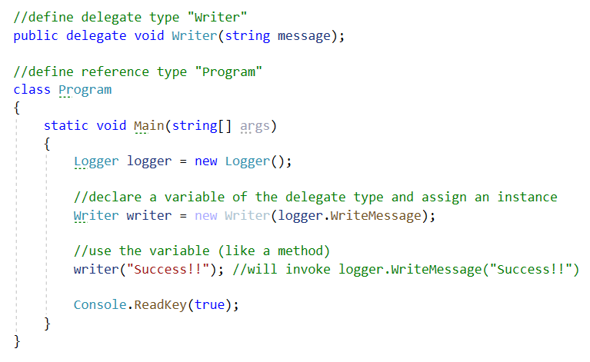
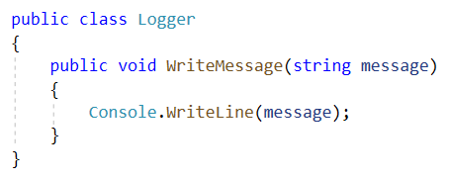
Delegates
How to create a variable that references a method?
A delegate is a type that references methods
Notes:
Here is the story of a delegate, which will lead us into events because events are based on delegates.
Imagine you want to declare a variable that references a method, so you’re not declaring a variable to hold an integer or point to a string or point to an object.
You want to declare a variable and point the variable to a method.
That means you have a variable that encapsulates executable code and you can invoke the variable just like you invoke a method.
You can use parentheses on the variable and optionally, pass in some arguments.
Now imagine you have a class called Logger. You can instantiate a Logger and once you have a variable referencing a Logger (e.g. “logger”) you can say logger.WriteMessage(“some message”).
You invoke the method through the object instance.
You can also write a bit of code that instantiates a Logger and then instantiates a delegate that references the WriteMessage method itself.
You will need a delegate type in order to be able to create a variable of that type.
The following statement defines a delegate type Writer:
public delegate void Writer(string message);
We’ll talk more about defining delegate types later on.
The following statement declares and assigns a variable of the delegate type Writer:
Writer writer = new Writer(logger.WriteMessage);
With the new keyword an instance of the Writer delegate type is created.
The constructor of a delegate type expects a method that returns void and has a string parameter. We pass in logger.WriteMessage.
Note that the WriteMessage method is not invoked (no parentheses after WriteMessage). We are literally passing the WriteMessage method to this writer delegate and saving the delegate in a variable named writer.
Now you can invoke logger.WriteMessage just by invoking the variable named writer:
writer(“Success!!”);
You just apply parentheses to the variable and pass the string parameter that you want the logger to use.
So that last line of code will call the WriteMessage method on the logger instance.

Slide 41

Defining a delegate type
A delegate is a type just like a class
Type definition looks like a method definition:
Describes the kind of methods that can be assigned to a variable of the delegate type
Return type and parameter types must match (same signature)
No body {} in a delegate type definition
Behind the scenes a class (e.g. Writer) is generated by the compiler that inherits from MulticastDelegate
Notes:
A delegate is a type, just like a class is a type and a struct is a type.
Instead of using the class or struct keyword, a delegate type is declared by using the delegate keyword.
Behind the scenes the compiler generates a new reference type (class) using the delegate type definition.
The generated class derives from the abstract MulticastDelegate class and is dedicated to referencing methods.
Because it's working with methods the type definition looks much different than a class definition:
public delegate void Writer(string message);
The type definition looks almost like a method definition because you can see a return value (void in this case), you can see parameters and you can see parentheses.
Unlike a class or a struct, a delegate has no body between curly brackets.
A delegate type describes the kind of methods that you want to call. Variables of the delegate type can contain only methods that have the same signature (same return type, same parameter types).
In this case the method assigned to a variable of the Writer type has to be a method that returns void and takes one string parameter.
The name of the method doesn't matter. The name of the parameter doesn't matter. It just has to be any method that returns void and takes one string parameter.

Slide 42
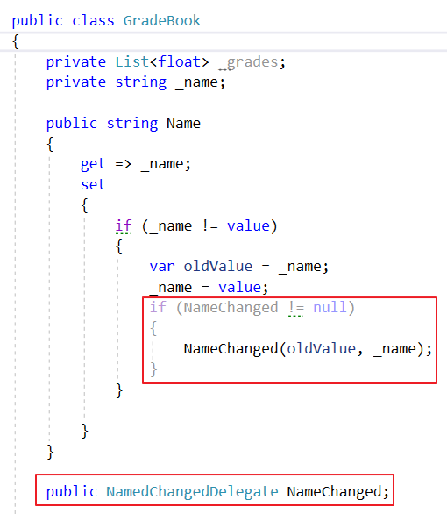
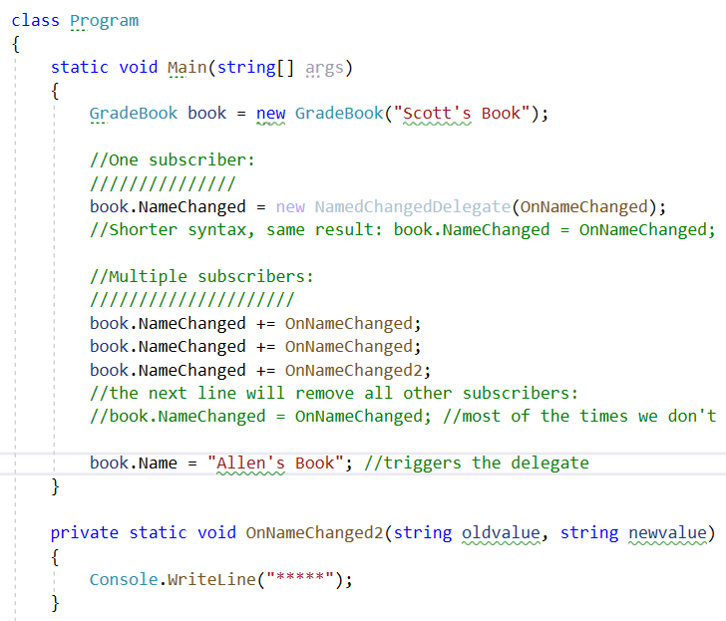
Using delegates
Demo: GradeBook
Notes:
When the GradeBook invokes the NameChanged delegate the OnNameChanged method of the Program class is executed. This is because the OnNameChanged method was added as a subscriber in the Main method.
After the subscription, the NameChanged delegate points to the OnNameChanged method.
One of the interesting things to think about, at this point, is that the GradeBook has no idea what code is going to execute when it calls NameChanged.
All it knows is that that delegate was pointing to something, it was referencing a method, and so it should invoke it.
This is a nice decoupling where the GradeBook doesn't have to know about specific components that are listening or need to know when a name changes.
The GradeBook doesn't need to know that there’s (for example) a data binding system somewhere in the software that wants to know when the name is changing so it can update the screen, that's a very nice decoupling,

Slide 43



Using delegates
One subscriber
Use “=” operator:
Removes al other subscribers (if any)
Shorter syntax:
Multiple subscribers
Use “+=” operator:
Method gets added to a list of methods that should be called when the delegate is invoked
“-=” operator to remove a method from the list:
Notes:
However, the way things are implemented right now, anyone can walk up and point the NameChanged delegate to another method.
That will overwrite anyone else who has previously set the NameChanged delegate.
There is another syntax that you can use in C#:
You can say ‘NameChanged += OnNameChanged’
When the GradeBook invokes the NameChanged delegate, it can actually have an entire list of methods that need to be invoked.
It could call 1 method or it could call 10 methods. The ‘+=‘ operator adds the method to the list of subscribed methods.
So in Program you can actually wire up that delegate twice to the same method.
You could even create another method OnNameChanged2 and add it to the list.
Now when the GradeBook invokes that delegate it's actually going to be calling three pieces of code.
It's going to be calling OnNameChanged twice because we added that into the delegate twice. And it will call OnNameChanged2 once.

Slide 44

Events
Is a delegate that does not allow the ‘=’ operator
Add the event keyword in de member declaration
Notes:
A problem with delegates is that there can always be some sort of rouge piece of software somewhere in my system that uses the ‘=’ operator instead of the ‘+=’ operator.
The rouge piece of software will thus wipeout all the methods that were already registered.
We want the GradeBook to be able to have multiple subscribers listening to a NameChanged event.
This is the exact scenario that events were designed to solve.
You want multiple subscribers to register methods to execute when something interesting happens and you don't want any single subscriber to come along and interfere with anyone else that wanted to listen for that event.
Instead of just using a delegate in GradeBook, you can use an event, which will prevent that scenario, and it will prevent someone from overriding any other subscribers.
Once you understand delegates in C# it becomes very easy to understand events because events are delegates.
There's just one thing I need to do syntactically to promote the NameChanged delegate of GradeBook from being just a public delegate that anyone can walk up to.
You can promote it into being an event by adding a keyword in the C# language: event.
Now, I don't need to change anything else inside of GradeBook. NameChanged is still a public delegate variable.
But by placing this event keyword in the member declaration, the C# compiler treats this public member a little bit differently.
You can see in Program.cs where the compiler will find an error when you use something like ‘book.NameChanged = OnNameChanged;’
Using the ‘=‘ operator is no longer syntactically correct because it's no longer legal to assign to an event.

Slide 45
Event conventions
99,9% of all events in .NET follow a certain convention
2 parameters
sender (Object)
Instance of the object that has sent the event (e.g. a GradeBook instance)
Use this keyword when invoking the event
args (type that inherits from EventArgs class)
Holds information a subscriber might need to know
Return type = void
Notes:
99.99% of all events in. NET follow a certain convention that we are not following right now.
With an event you would just never pass arbitrary parameters like string and string.
All events in.NET take two parameters:
Object sender
Let’s the subscriber know who is sending the event
E.g. the GradeBook needs to pass itself as the object that is raising the event
The second parameter is an object that encapsulates all other information that a subscriber might need to know about this event.
Should be a type that inherits from the EventArgs class
Define properties for the pieces of information subscribers need

Slide 46
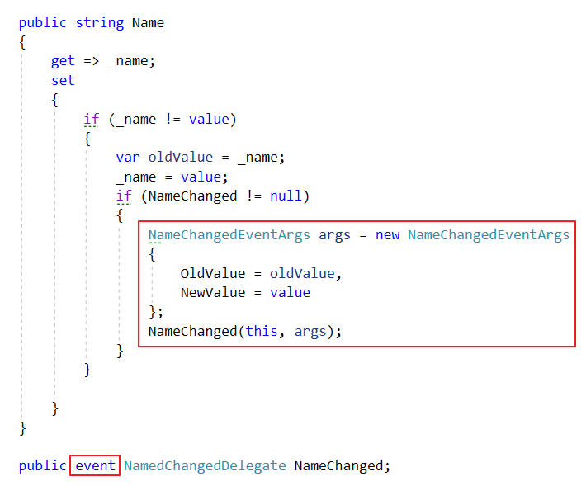

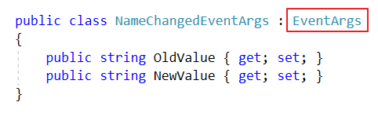
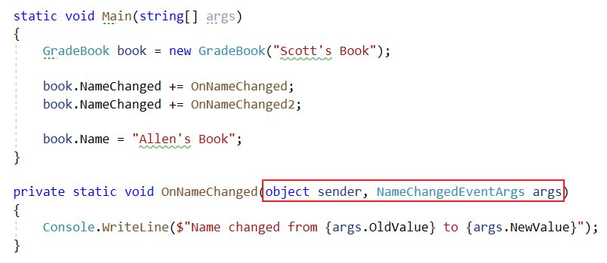
Event conventions
Demo: GradeBook

Slide 47
Pluralsight
Required:
C# Fundamentals
Module “Members: Methods, Events and Properties”
Clip: An Overview of Events
Clip: Delegates
Clip: Events Redux
Optional (for a deeper/better understanding):
C# Events, Delegates and Lamda’s
Module “The Role of Events, Delegates and Event Handlers”
Module “Creating Delegates, Events and EventArgs”
Module “Handling Events”

Slide 48
lambda’s
C# language features

Slide 49
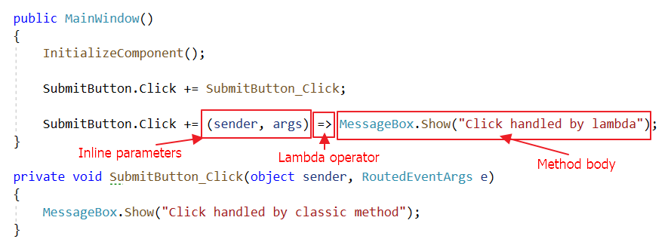
Lambda syntax
Inline method
Parameter names inside parentheses ()
Lambda separator =>
Method body
Parameter types and return type are inferred by the compiler
Notes:
A lambda expression is a way to define an inline method.
E.g. SubmitButton.Click += (sender, args) => MessageBox.Show(“Click handled by lambda”);
The first part of the lambda expression defines the parameters between parentheses.
You can choose any name for each parameter of the inline method.
Note that no parameter types are defined. The compiler can infer these because the lambda is assigned to a delegate that expects a method with an object parameter and a RoutedEventArgs parameter.
The middle part of the lambda expression is the lambda separator (=>) which separates the first and last part.
The last part of the lambda expression contains the method body.
Note that there are no curly brackets. These can be omitted because there is only one line of code in the body.
When you want to have multiple lines of code in the body you will need to use curly brackets {}.
The compiler is also able to infer the return type (void) because the lambda is assigned to the Click event.

Slide 50
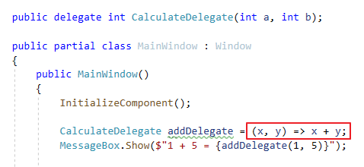
Lambda syntax
No need for return keyword when the body only contains one line of code
Notes:
The compiler can infer that an int should be returned because the lambda is assigned to a CalculateDelegate.
So you can omit the return keyword.

Slide 51
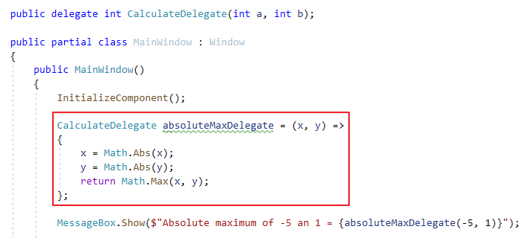
Lambda syntax
With multiple lines of code in the body a return statement and curly brackets are needed

Slide 52
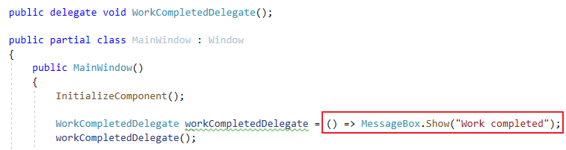
Lambda syntax
If there are no parameters, write empty parentheses

Slide 53
Action<T>
Built-in generic delegate in .NET
Accepts a single parameter of type T
Returns void
Multiple parameters:
2 parameters: Action<T1, T2>
3 parameters: Action<T1, T2, T3>
…

Slide 54

Function<T, TResult>
Built-in generic delegate in .NET
Accepts a single parameter of type T
Returns TResult
Multiple parameters:
2 parameters: Func<T1, T2, TResult>
3 parameters: Func<T1, T2, T3, TResult>
…

Slide 55
Pluralsight
C# Events, Delegates and Lamda’s
Module “Lambdas, Action<T> and Func<T, TResult>”
Notes:
Note: In the last clip LINQ is used. LINQ will be covered in one of the next chapters…

